Slide 1
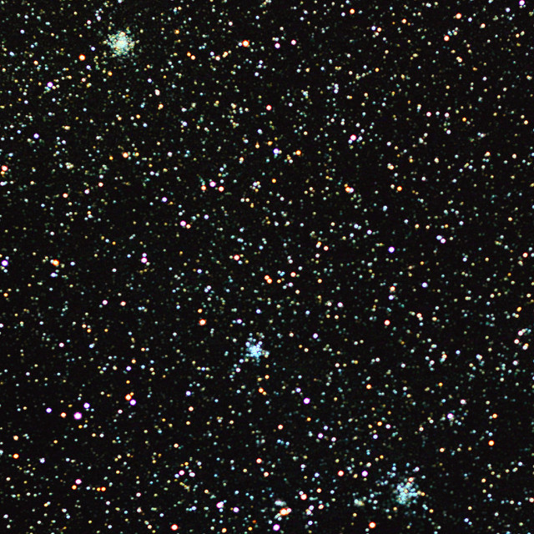
Clusters in Auriga
M36: Pinwheel Cluster
M37: Open Cluster
M38: Starfish Cluster

Slide 2
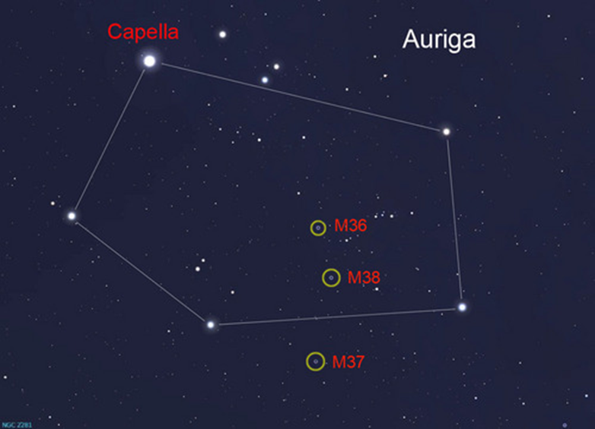
Clusters in Auriga
M36: Pinwheel Cluster
M37: Open Cluster
M38: Starfish Cluster

Slide 3
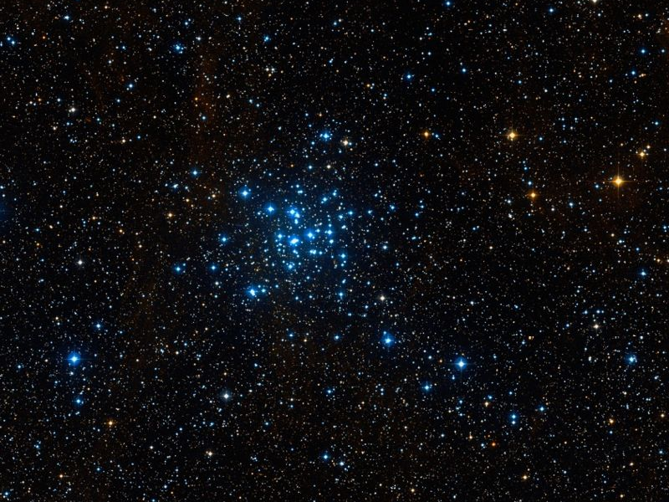
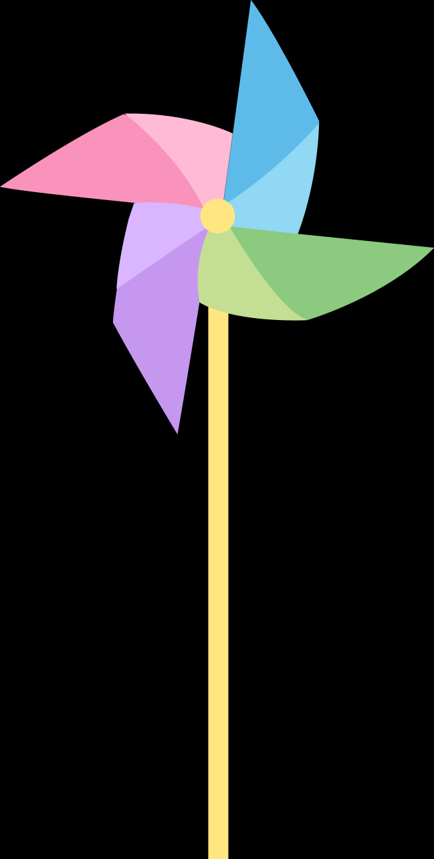
M36: Pinwheel Cluster

Slide 4
M36: Pinwheel Cluster
Visual Magnitude: +6.0
Apparent Size: 10.0 arcminutes
Distance: 4,300 light years away
Diameter: 12.6 light years across

Slide 5
M36: Pinwheel Cluster
First discovered in 1654 by Giovanni Batista Hodierma
Guillaume Le Gentil independently discovered it in 1749 (along with M38)

Slide 6
M36: Pinwheel Cluster
Contains around 60 stars, mostly young, hot, blue main sequence stars
It appears to be around 25 million years old.

Slide 7
M36: Pinwheel Cluster
It is about 10 times further away than the Pleiades, but if it were the same the distance, it would be at least 3 times as bright.
It burns with the luminosity of 8,000 Suns.

Slide 8
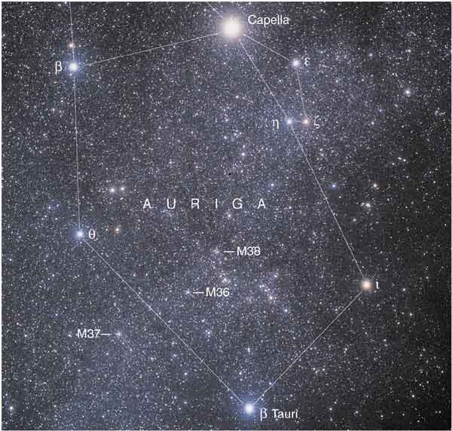
Clusters in Auriga
M36: Pinwheel Cluster
M37: Open Cluster
M38: Starfish Cluster

Slide 9
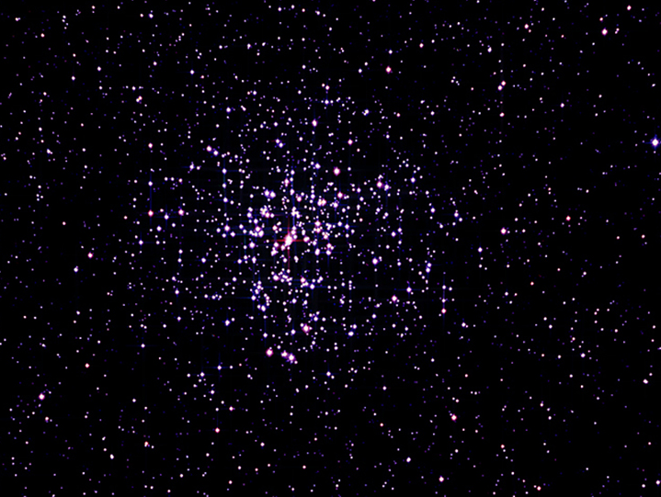
M37: an open cluster
Visual Magnitude: +5.59
Apparent Size: 14.0 arcminutes
Distance: 4,500 light years away
Diameter: 18.4 light years across

Slide 10
M37: an open cluster
First discovered in 1654 by Giovanni Batista Hodierma
While Guillaume Le Gentil independently discovered M36 & M38 in 1749, he missed this one.

Slide 11
M37: an open cluster
Contains at least 150 stars, maybe even as many as 500. Most are between 9th and 12th magnitude or brighter.

Slide 12
M37: an open cluster
It is about the same age and size as nearby M38. It’s about 300 million years old.
It contains mostly main sequence type A stars and at least a dozen red giant stars.

Slide 13
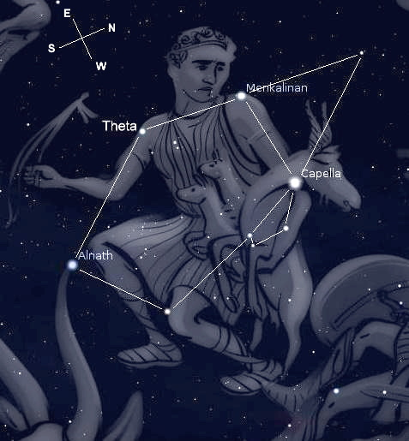
Auriga
“the charioteer”
M37
M38
M36

Slide 14
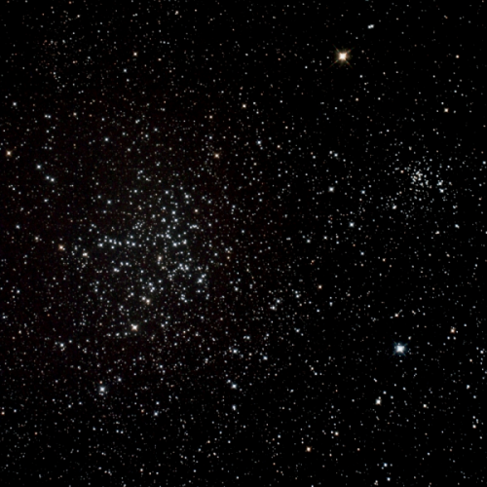
M38: Starfish Cluster

Slide 15
M38: Starfish Cluster
Visual Magnitude: +6.40
Apparent Size: 20.0 arcminutes
Distance: 4,600 light years away
Diameter: 26.6 light years across

Slide 16
M38: Starfish Cluster
First discovered by 1654 by Giovanni Batista Hodierma.
It was independently discovered by Guillaume Le Gentil in 1749 (along with M36).

Slide 17
M38: Starfish Cluster
Contains over 100 stars, many 9th magnitude or brighter. Its brightest star is a yellow giant.
It is about the same age and size as nearby M37. It’s about 220 million years old.

Slide 18
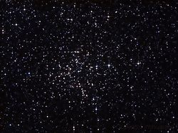

M38: Starfish Cluster
The brightest stars form an asterism of the Greek letter Pi or a cross shape.

Slide 19

M38: Starfish Cluster
The brightest stars form an asterism of the Greek letter Pi or a cross shape.

Slide 20


M38: Starfish Cluster
Which shape do you see?

Slide 21
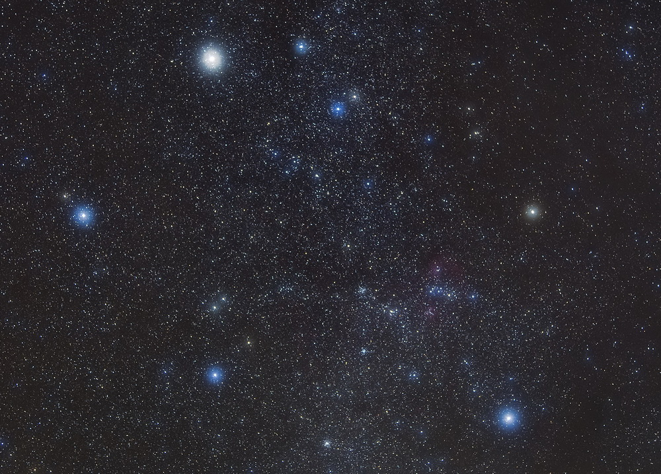
Auriga
M38
M36
M37

